Slide 1
Working with the new AEM Assets View

Slide 2
Section 5 Content Hub

Slide 3
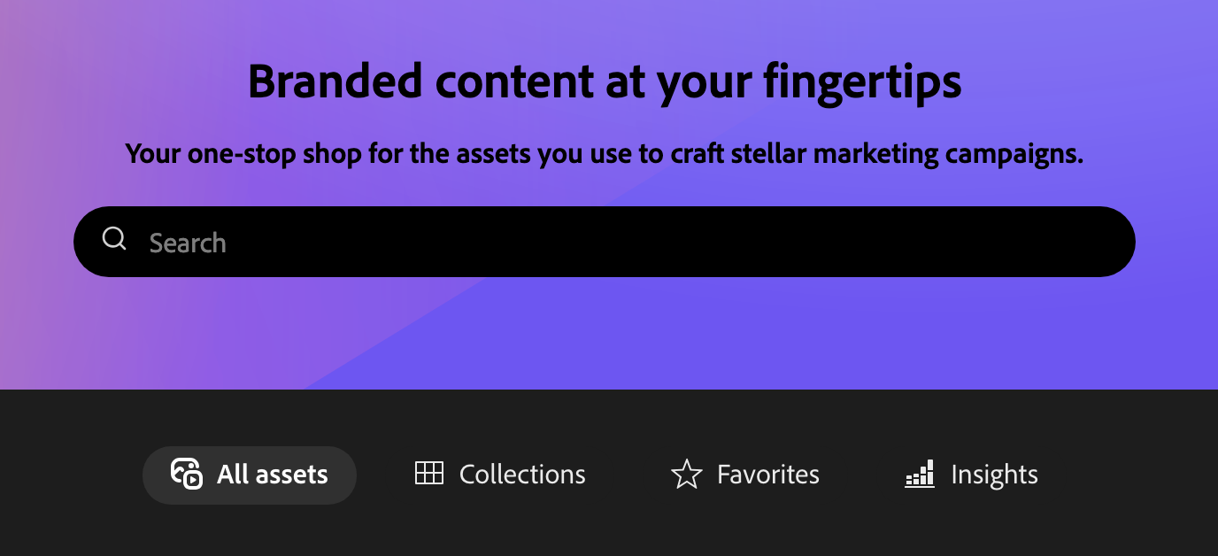
Introducing Content Hub
• A curated, user-friendly portal for finding and using brand-approved assets
• Designed for non-technical users (search, filters, collections)
• Backed by Assets governance, not a separate asset manager
• Optimized for distribution and reuse (not authoring or admin workflows)

Slide 4
Why Content Hub matters
Self-serve access: teams can find what they need without waiting for handoffs
Brand safety: approval-based governance before broad use
Searchable and reusable: metadata makes assets easy to discover
One “source of truth”, reducing duplicates and outdated versions in the wild
In practice:
Content Hub is the “front door” for asset consumers.
Assets view is typically where authors/admins manage governance.

Slide 5
Where Content Hub fits
High-level flow (simplified)
Adobe Experience Manager Assets
Content Hub
Downstream use
Adobe Experience Manager Assets = system of record and governance
Content Hub = distribution and consumption experience
Downstream = marketing, comms, agencies, Express, etc.

Slide 6
Life of an Asset via Content Hub
Upload
Add metadata
Approve
Use
Upload through Content Hub and apply metadata
Approval happens in Assets view
Once approved, the asset is ready for broad distribution and reuse

Slide 7
Asset Approval (revisited)
While Content Hub is for consumption and reuse, Assets view is often where the governance happens.
Uploaded does not mean ready for broad use
Approval is the governance checkpoint for brand safety
Approvers can validate: correct asset, correct metadata, correct rights
If auto-approval is set to OFF, this step is always required

Slide 8
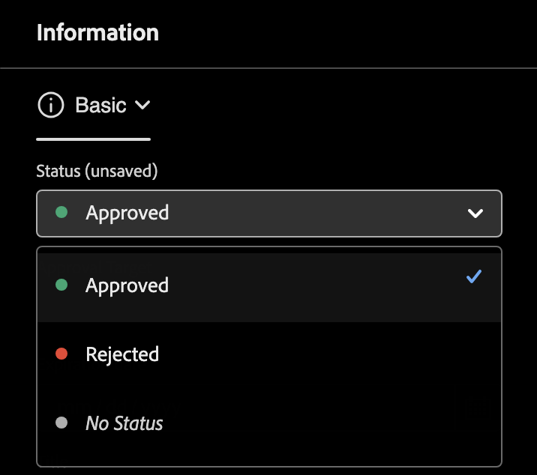
Asset Approval
To approve an asset:
Open Assets view
Locate the uploaded asset (e.g., search for the asset’s title) and preview.
Set status to approved.
Save the asset.

Slide 9
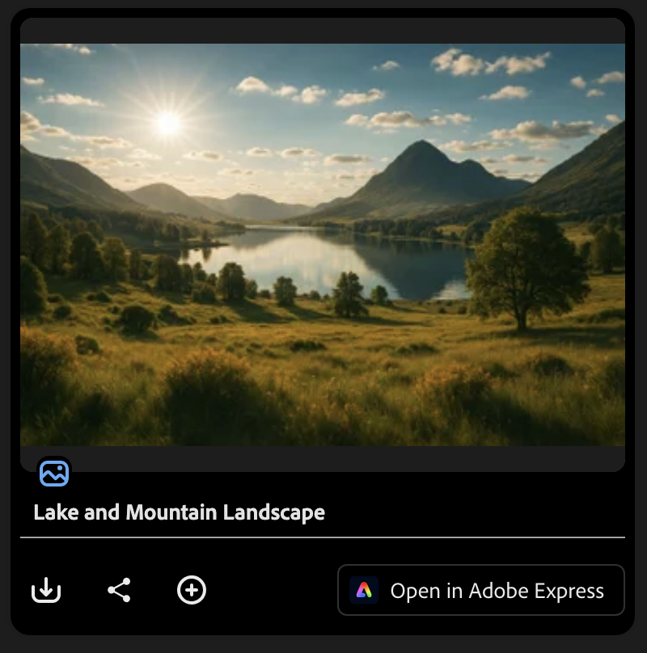
Verify approval back in Content Hub
• Return to Content Hub and refresh the browser
• Search for the asset again
• Confirm it’s visible (refresh the browser).

Slide 10
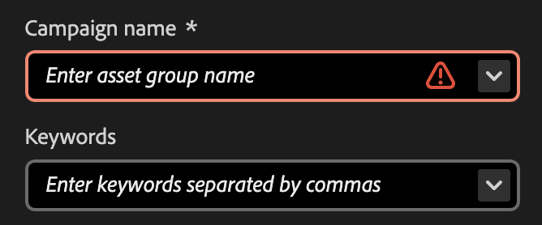
Exercise 5.1: Upload Asset via Content Hub
Inside Content Hub, choose Add Asset and upload an image.
Enter Metadata including the Campaign name and Keywords.
Ensure Keywords are separated by commas.
Then, click Upload to complete the process.

Slide 11
Exercise 5.2: Approve and Check
Navigate to Asset View.
Locate the uploaded asset by searching for it.
Open the Hydrated Assets folder.
Within the asset’s details, change the status property to approved and save the changes.
Go back to Content Hub to verify the asset.

Slide 12
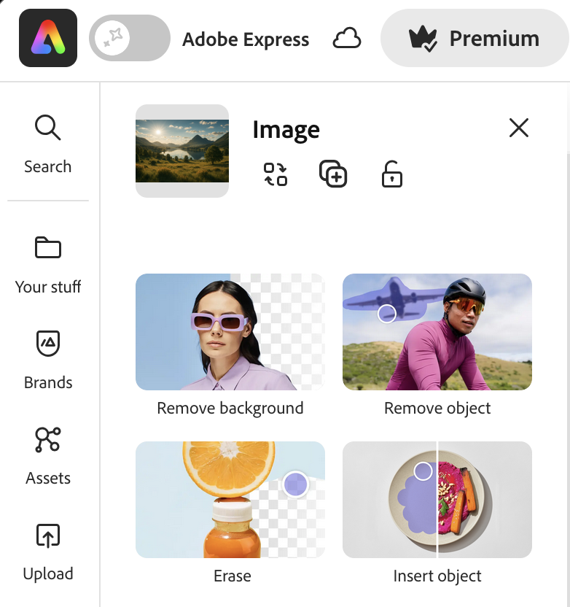
Adobe Express integration (overview)
Uses approved assets as starting points for quick on-brand variations
Great for lightweight edits: resize, layout variations, simple text overlays
Keeps teams in the approved asset ecosystem (less off-platform drift)
Upload > Metadata > Approve > Use / Create variations

Slide 13
Key Takeaways
Content Hub is a self-serve way for teams to find and use brand-approved assets quickly.
Use metadata (title, description, tags/keywords, usage/rights, campaign/product) so assets are searchable and reusable.
With auto-approval off, an upload isn’t broadly usable until it’s approved.
Approval happens in Assets View, then verify the asset is available back in Content Hub.
When enabled, Adobe Express lets users create quick, on-brand variations from approved assets.

Slide 14

Questions?
Image by Ran Zheng

Slide 15
Closer Slide

